Slide 1
Amazon Fine Food Review Analysis
Team 2
Abhishek Shivaprakash
Shengjie Shi
Xinlei Ma
Yue Shangguan
Viraj Karnik
Vivek Jayaraman

Slide 2

Project Summary
Explanation of Project Content
Why we Do:
Amazon is the fastest growing companies in the USA with focus of their online marketplace always being on capturing market share and getting the best output from each of its users. 55% of shoppers start their buying research on Amazon and 50% all shoppers say they rely primarily on Amazon for reviews. They provide a means to judge how influential their reviews are on other customers and how their reviews can be used to increase the output from other customers.
CRAS ULTRICIES LIGULA SED MAGNA DICTUM PORTA.
What We Will Do:
Finding out whether the review is a positive or a negative one and how well the other users agree on these reviews
Focusing on specific users to generate patterns of preference on so that they can be recommended better products in the future
What We Will Deliver:
Project brief
Project proposal presentation
R Script
Final presentation

Slide 3
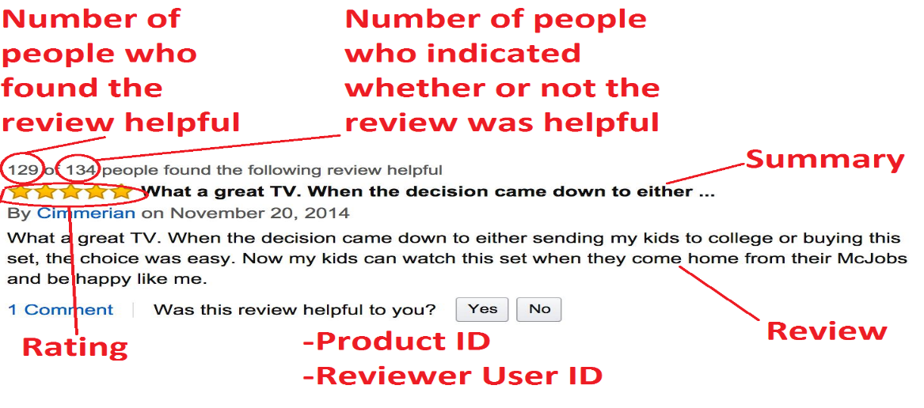
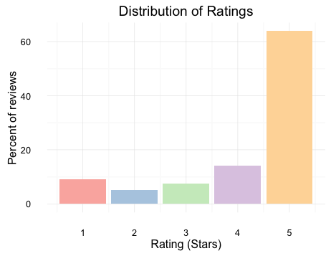
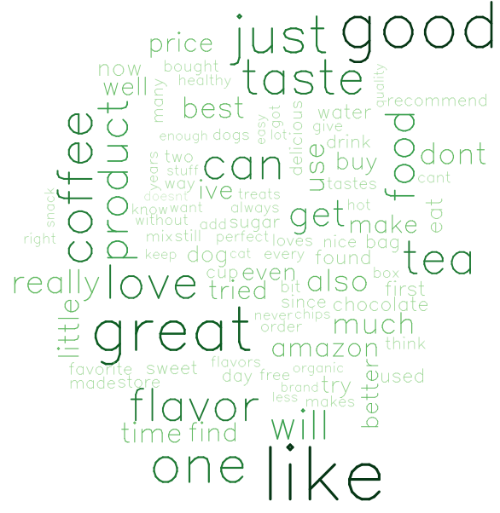
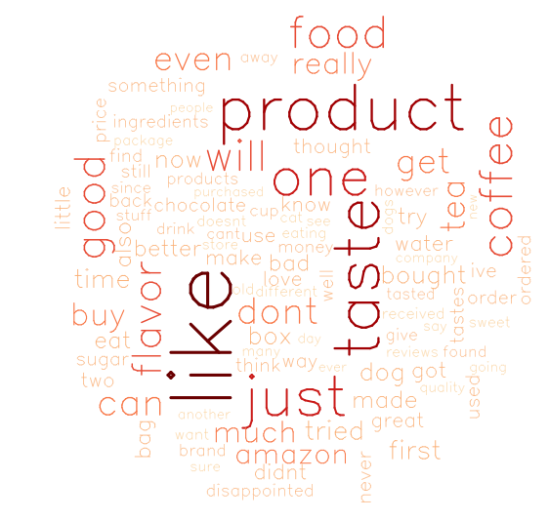
Data Summary
Brief of Exploration Data Analysis
568455 text reviews
CRAS ULTRICIES LIGULA SED MAGNA DICTUM PORTA.
Distribution of ratings
We see that 5-star reviews constitute a large proportion (64%) of all reviews. The next most prevalent rating is 4-stars(14%), followed by 1-star (9%), 3-star (8%), and finally 2-star reviews (5%).
Common words in positive and negative reviews
Both positive and negative reviews share many popular words, such as "like", "taste“.

Slide 4





Methodology—Text Mining
The Methods of Modeling
Data cleaning
Natural language processing
Sentiment & Topic Detection
Visualization & LDA tool
CRAS ULTRICIES LIGULA SED MAGNA DICTUM PORTA.
Preprocess the text data
Remove stop words
Parts of Speech tagging (identify verb, noun, etc.)
Tokenization (extract words, removing punctuations, numbers)
Sentiment analysis( Positive & Negative)
Topic detection
Word frequencies & word clouds
Sentiment scores
Word correlation
Topic visualization & profiling

Slide 5





Methodology—Predictive Analytics
The Methods of Modeling
Confirm the dataset
CRAS ULTRICIES LIGULA SED MAGNA DICTUM PORTA.
Measure the performance of the model
Clean the data
Predictive Analytics
Apply model
Create models
Test models

Slide 6
Project Success
The Methods of Metrics and Evaluation of Project
Using cross-validation to prevent overfitting; using precision, recall, and accuracy to evaluate the performance of a classifier; ROC curve and AUC value, prefer ROC curve performance.
No numeric tools to score the performance of user behavior analysis; we will build top 10 users’ food preference profile to generate business recommendations and implications to Amazon.
Do our best effort to keep the project on the original timeline; update our project schedule regularly, at least once every two days; look at our major milestones and check the project on the prorate process.
Sentiment Analysis
User Behavior Analysis
Schedule

Slide 7
Users Stories
Positive and Negative Impact on Stakeholders
P1
P2
P3
Keep constant tabs on what people like and do not like about the food product.
Zero in on which segments like which things, and how to appeal to those audiences.
Empower Amazon product development team with incredible insight into specifics of product performance.
The data is too old and we do not use the crawl to gain the real time reviews, which may decrease the contribution to the future analysis.
We do not have more information like brand, size, color, etc., which may create some bias for the result.
N1
N2

Slide 8
Milestones
Detailed Plan of Each Date
Deliverables | Begin | Duration | 04/25 | 04/26 | 04/27 | 04/28 | 04/29 | 04/30 | 05/01 | 05/02 | 05/03 | 05/04 | 05/05 | 05/06 | 05/07
Topic Selection | 04/25 | 1
Dataset Identification | 04/26 | 1
Project Brief | 04/27 | 3
Dataset Cleaning | 04/27 | 5
Descriptive Analysis | 04/28 | 4
Project Pitch Slides | 04/27 | 3
Text Mining | 04/30 | 5
Predictive Analysis | 05/01 | 4
Users Behaviors Analysis | 05/04 | 2
Final Presentation Slides | 05/04 | 4
CRAS ULTRICIES LIGULA SED MAGNA DICTUM PORTA.

Slide 9
THANK YOU

